Slide 1

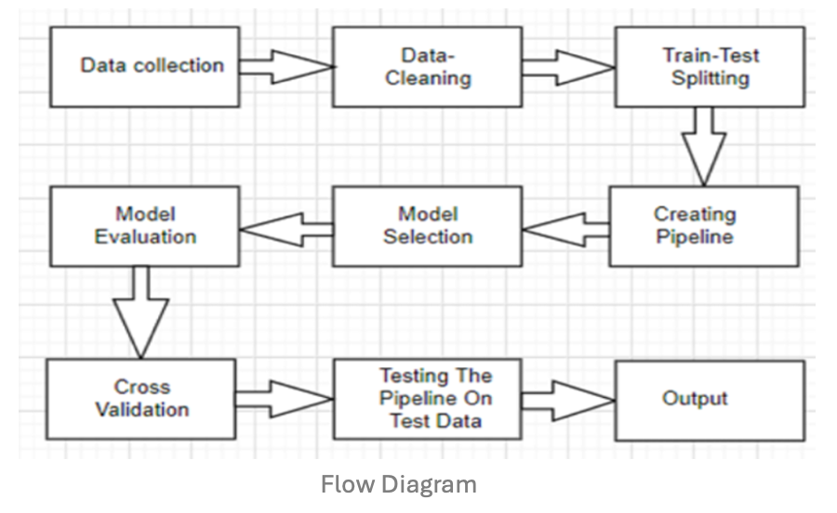
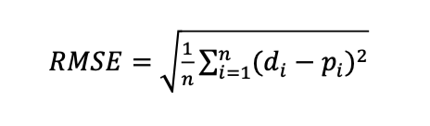
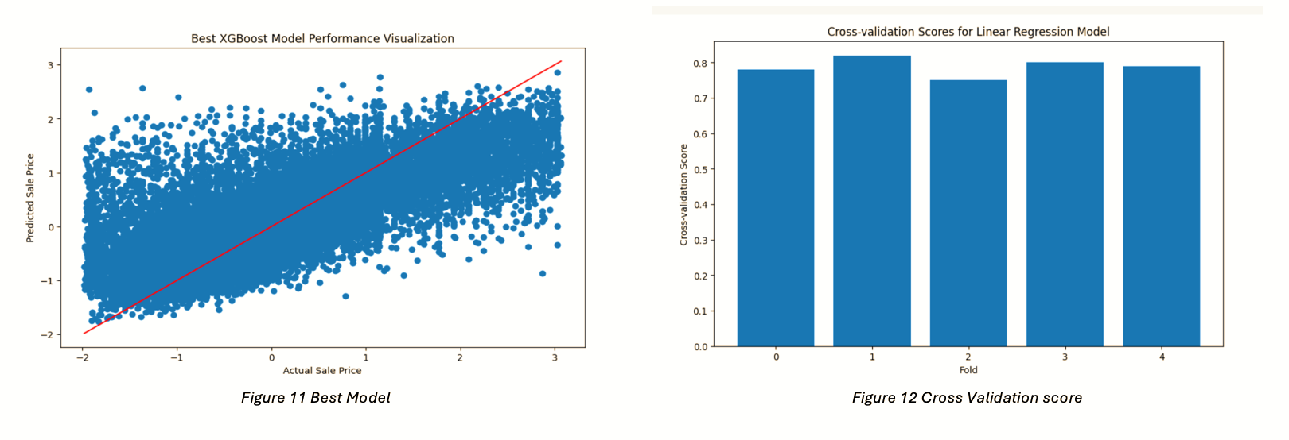
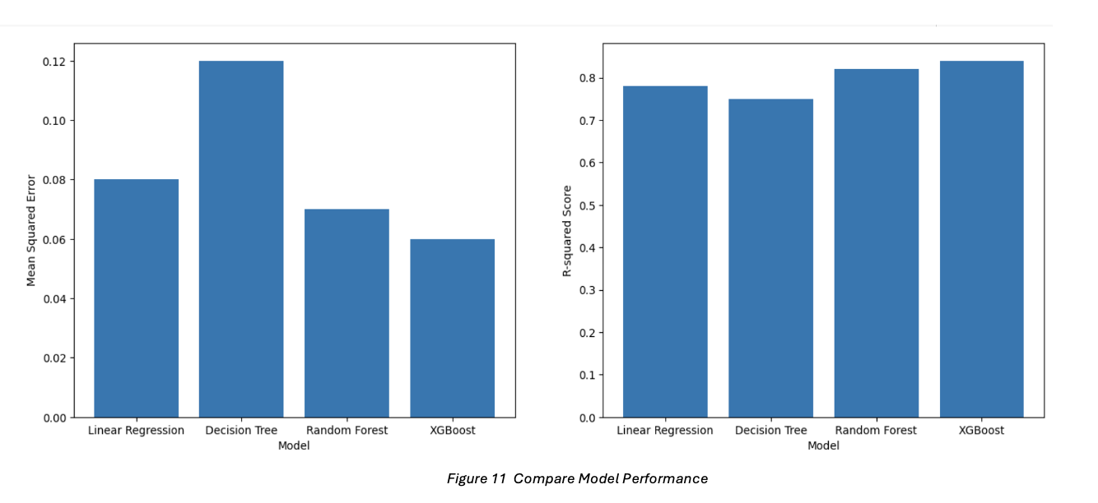
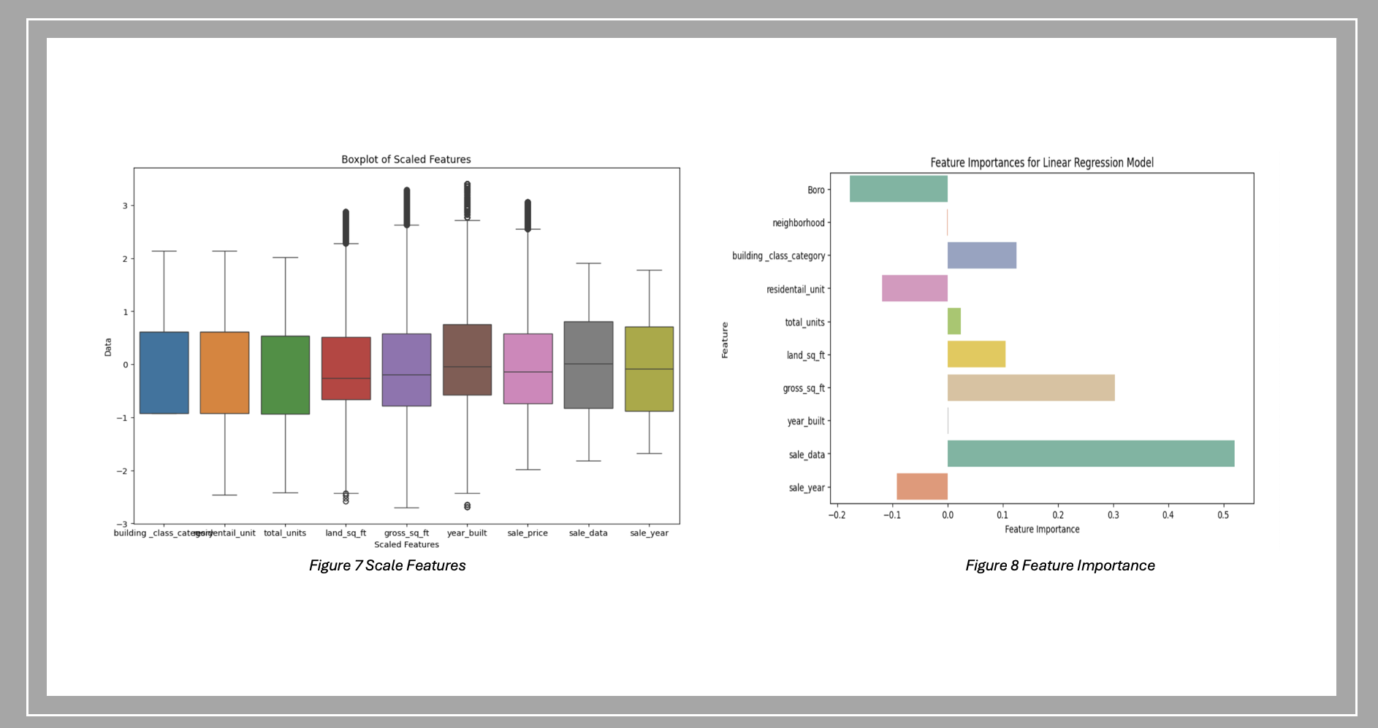
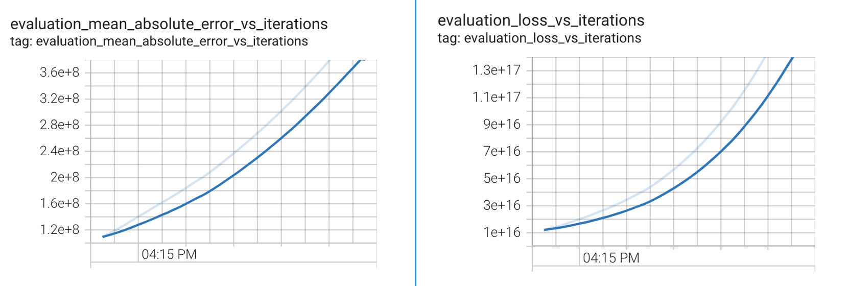
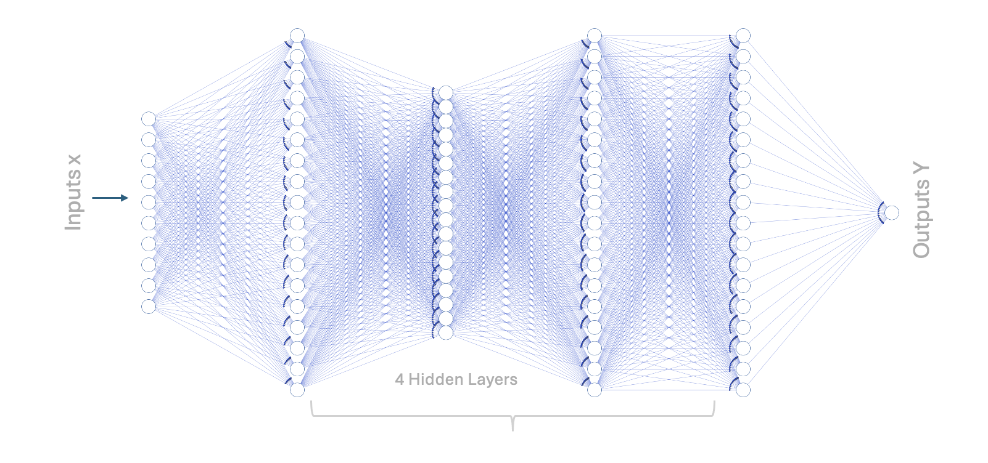
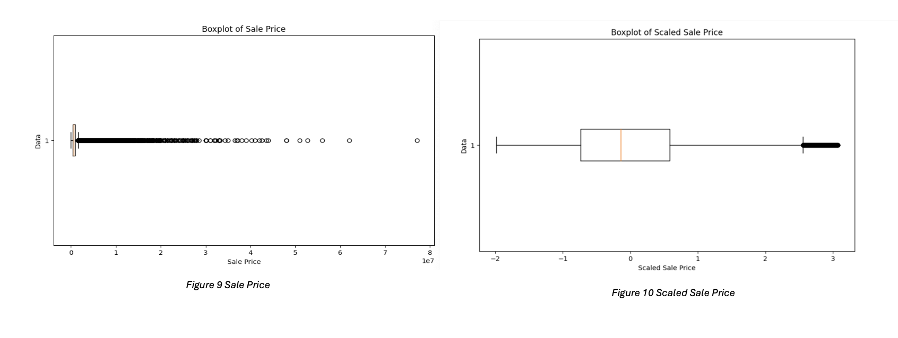
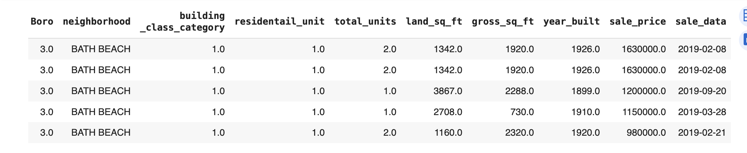
New York City Sale Price Prediction
Sunita Inderjit
Seidenberg School of Computer Science & Information Systems
INTRODUCTION
METHODOLOGY
RESULTS
CONCLUSION
New York City, known for its dynamic real estate market, incorporates diverse neighborhoods, each with unique characteristics and market trends. The city's property landscape has been a subject of interest for investors, homeowners, and foreigners alike. This project uses Machine Learning and Deep Learning techniques to analyze the Neighborhood Sales summary data for Manhattan, Brooklyn, and Queens from 2009 to 2022. By analyzing the trends and patterns in this data, the goal is to provide valuable insights into the real estate dynamics of these boroughs, helping in better decision-making for various stakeholders and policy makers
Performed advanced data preprocessing: Implement a rigorous data preprocessing pipeline to clean, standardize, and normalize the data. This includes dealing with missing values, outliers, and inconsistent entries to prepare data for accurate machine-learning modeling.
Different regression techniques were employed linear regression, decision tree, random forest, and XGBoost to build predictive models for NYC sale prices. Performance metrics such as Mean Squared Error (MSE), which measures the average squared difference between the predicted and actual sale prices
This analysis provides a comprehensive overview of the NYC real estate market, specifically focusing on predicting sale prices for one to three family residential units in Manhattan, Brooklyn, and Queens from 2009 to 2022. The XGBoost model, with tuned hyperparameters, demonstrated the best performance in predicting sale prices, with an MSE of 0.06 and an R-squared value of 0.84. The findings highlight the importance of considering various factors, such as borough, neighborhood, and property type, when assessing sale prices..
Evaluation and validation framework
Mean Absolute Error (MAE), Root Mean Squared Error (RMSE), R-squared (R²):
BACKGROUND
The project aims to analyze historical real estate sales data from 2009 to 2022 in Manhattan, Brooklyn, and Queens. By identifying patterns, trends, and key factors such as ( square footage, building class, property age neighborhood, etc) influencing neighborhood sales in the complex New York City real estate market
Feature Engineering and Selection: Carried out extensive feature engineering to create new predictive variables and perform feature selection to identify the most significant predictors of real estate prices.
Artificial Neural Network Regression Model
4 hidden layers, 30 neurons, and with 100 epochs. The model's performance evaluation metrics, indicates a moderate level of accuracy in predicting house prices.
DATASET
13 years of data was used for this project, Total of 36 datasets were combine to form one comprehensive dataset. The original dataset consisted of all real estate sales which includes commercial, residential and deed transfer transactions. For my analysis, I only focus on one to three family residential units within the three boroughs Manhattan, Brooklyn and Queens. Dataset contains 218,126 row and 17 columns.
Outliers were identified using box plots and removed based on the interquartile range (IQR) method to ensure data integrity and accuracy
REFERENCES
Annualized sales update, www.Nyc.Gov/site/finance/property/property-annualized-sales-update.Page. Accessed 7 mar. 2024.
Google scholar was utilized for the retrieval of academic articles and resources relevant to the research. Available at: https://scholar.Google.Com. [Accessed: 10 feb. 2024].”
"Academia.Edu. (N.D.). Retrieved [accessed 10 feb, 2024], from
Data.Gov. (N.D.). Retrieved [access 1 march 2024], from https://data.Gov/"
Mean Absolute Error (MAE): 161619.09267071213 Mean Squared Error (MSE): 50805277063.59843 Root Mean Squared Error (RMSE): 225400.2596795275
R-squared (R²): 0.5029391141016842

